Slide 1
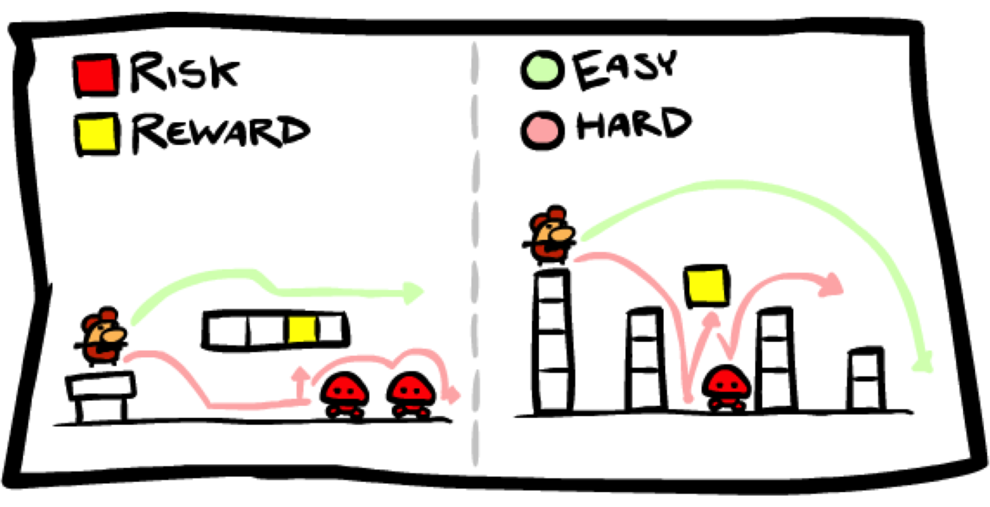
OCR Level 02 – Cambridge Technical
Unit 05 – Creating Business Solutions
2016 Specification - L/615/1355
LO2 - Produce a Game Design

Slide 2
Assessment Criteria
The Learner will | Pass The assessment criteria are the pass requirements for this unit. The learner can: | Merit To achieve a merit the evidence must show that, in addition to the pass criteria, the learner is able to: | Distinction To achieve a distinction the evidence must show that, in addition to the pass and merit criteria, the learner is able to:
1. Know the fundamentals of game design | P1: Describe the fundamentals of game design
2. Be able to generate Game Designs | P2: Outline the game concept | M1: Justify how the concept meets the purpose and features of the game
 | P3: Present the game concept to stakeholders to obtain feedback
 | P4: Produce the design for the game concept based on feedback
3. Be able to create games from game designs | P5: Create the game | M2: Test the functionality of the game | D1: Evaluate the game against the design specification
4. Be able to recommend additional features for game designs | P6: Recommend additional features to improve game design | M3: Consider how the additional features would enhance the original game design | D2: Justify how the game design could be supported on multi-platforms

Slide 3
LO2 – Learning Outcome
Learning Outcome 2: Be able to generate game designs
Your task is to: present an original game concept to stakeholders and obtain feedback. Using the feedback, create a game design that can be created by a third party.
Pass | Merit | Distinction
P2: Outline the game concept | M1: Justify how the concept meets the purpose and features of the game
P3: Present the game concept to stakeholders to obtain feedback
P4: Produce the design for the game concept based on feedback
Evidence
A video, a presentation with speaker notes or a formal report. This must include: the game concept; justification of how the concept meets the purpose and features of the game. A video, an online survey or a questionnaire. This must include: feedback from stakeholders. Storyboards in a report or a prototype. This must include: a game design based on feedback.

Slide 4
Assessment Criterion P2, P3, M1, P4
P2 - Learners are required to produce an outline of the considerations of the game concept. This can be submitted as a formal report or presentation.
P3/M1 - Learners are required to present the game concept to obtain feedback. The presentation can take any format but must give the stakeholders a good overview of the game content, how it will work and the decision making process behind the game concept. The feedback can be through written questionnaires or verbal. If verbal, there should be some form of audio/video recording.
P4: Learners are required to produce the design for their game concept taking into account the stakeholder feedback. The design should be sufficiently detail to allow a third party to develop the game. The design documentation selected is flexible.

Slide 5
LO1 - Assessment Criterion
2.1 Game concept considerations, i.e.:
purpose
type (genre)
audience (e.g. demographics)
story
stage
characters
progression/levels
scoring
sound
control method
host platform
2.2 Present game concept, i.e.:
overview of concept
visualisation
reasons for decisions made
available options
viability of design
resources required
2.3 Gather feedback on the game concept, e.g.:
stage
characters
progression
scoring
fun
suitability for target audience
2.4 Create the game design, i.e.:
choice of software for game development
pseudocode
storyboard
mood board
help
assets

Slide 6
Unit 15 – Scenario – Progress Game Hut
Progress Game Hut
Part A
You are a junior game designer at Progress Game Hut. To gain a promotion as a fully endorsed game designer your manager, Harry has asked you to explain to the rest of the game design team the fundamental concepts of game design.
Part B
Design, create, test and evaluate a game.
You have now been allocated a new assignment. Harry wants Progress Game Hut to release a new gaming concept for each blockbuster movie as they are released throughout the year.
Your brief is to choose a film from future movie releases and design a game to promote the movie. You could choose a concept linked to a franchise e.g. ‘007’, ‘Star Wars’, ‘Toy Story’, ‘Despicable Me’ or a completely new blockbuster.
The aim of the game is to promote the new film through entertainment and cliff hangers. Harry aims to release the games at the same time as the blockbuster hits the cinema’s.
He has asked you to think carefully about the target audience.

Slide 7
P2.1 – Game Concept Outline
For P2 you have to producer a game concept proposal that covers all the following considerations:
purpose
type (genre)
audience (e.g. demographics)
story
stage
characters
progression/levels
scoring
sound
control method
host platform
First you need to research an upcoming film that has not yet been released, one that should or could have a game based on it. For the sake of discussion, I will focus on Toy Story 4, due to be released in late 2019.
For each of the client criteria I will need to use this film as my example. As the film seems like an adventure with quests to complete, things to find and the characters being small, a 3D platform game would seem the most appropriate format. As the film is aimed at children, my target audience will be 7-12. As the film will be huge, I will be aiming at cross console tablet market.

Slide 8
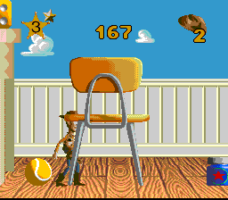
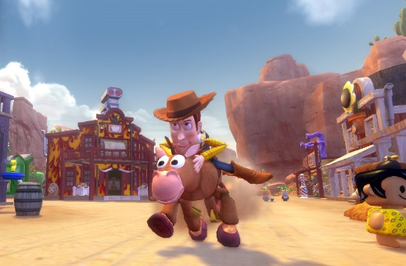
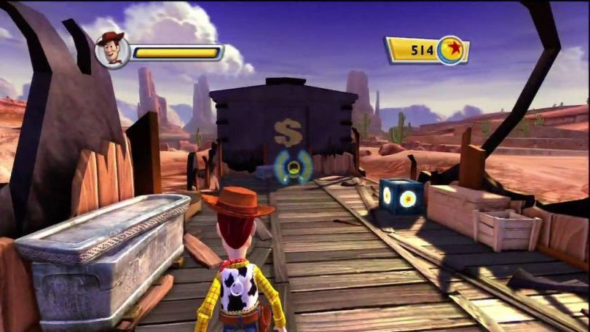
P2.1 – Game Concept Outline
P2.1 – Task 01 – Create a proposal report that outlines the Purpose, type and audience needs for the proposed game.
Purpose – The aim of the game will be to progress through the scene stages of the film by achieving each scene task. The character will use the abilities of the other Toy Story Characters to achieve these level tasks before progressing to the next scene stage. Each time the character needs to achieve the level task, open the way to the next level, not get caught being a toy.
Type (genre) – The game will be a range of genres, starting with platform for the interior house scenes, driving for the exterior outdoor scenes. As the character is small, this will involve a small character in a big world, large furniture, giant cars, humans etc.
Audience (e.g. demographics) - The game should be aimed at children between 7 and 12 due to the bright colours, the design of the characters, the age range of the toys referred to in the film. Due to this, the scenes should be short, and the difficulty set to a low level in order to progress. A lot f repetition will be involved so three should be some degree of object interaction and variety each time played.

Slide 9
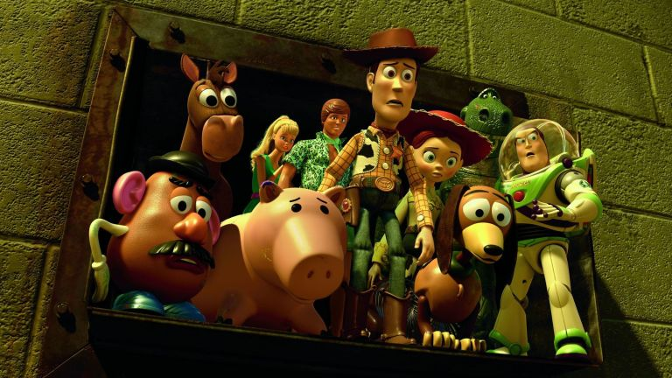
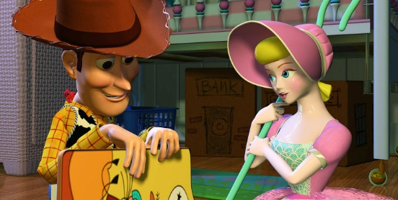
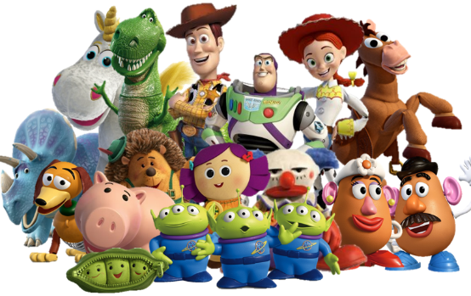
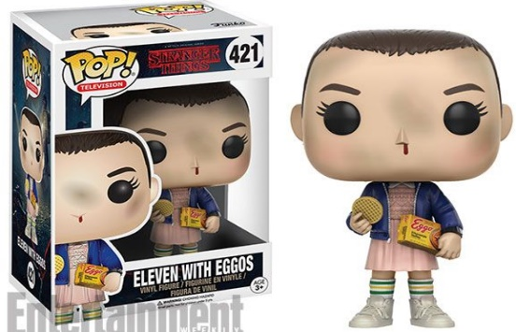
P2.1 – Game Concept Outline
P2.1 – Task 02 – Create a proposal report that outlines the Story, Stage and Characters needs for the proposed game.
Story – It will be something of a love story focusing on the characters of Woody and Bo Beep. A comment is made in Toy Story 3 that Bo was either lost or given away somewhere between the second and third films, so the plot will be focused on Woody’s attempts to reunite with his old flame. This will involve sheep, adventuring and an evil character, Old MacDonald.
Stage – The levels will be spread out over the home, a town scene, a farm yard, different countries as the plot develops on who bought Bo Peep after the yard sale and a series of cultural toy shops and foreign toy characters from good to bad.
Characters – The two main characters will be Woody and Buzz but the other toy story characters will be included preferably as character selections at the beginning of each level, each with their own attributes, flying, stretching, falling to pieces, in group and for strength.
New characters will have to be introduced as plot followers and bad guys in order to increase the salability of the game overseas.

Slide 10
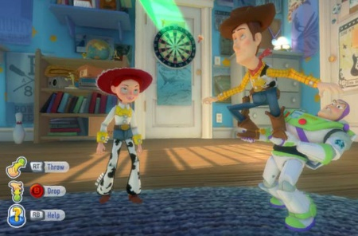
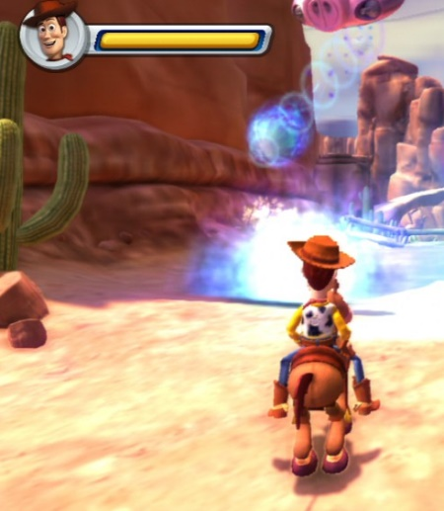
P2.1 – Game Concept Outline
P2.1 – Task 03 – Create a proposal report that outlines the Progression Levels, Scoring and Sound needs for the proposed game.
Progression / levels – Each level will be different and progression will be a matter of completing each level to move the plot along. The characters may gain new moral reward points for the good and bad actions they do as the game progresses which will change the way other characters react to them later in the game. This will allow the game to change with each new play.
Scoring – This will be done as items are collected in the game to help the characters progress and will be done more as items to be used than scores. As each level will be a little different, points may be rewarded for different achievements, not crashing in the chase sequences, reaching higher platforms in the platform sections.
Sound – The background music will be taken from the music of the movie, ‘You’ve got a friend in me’ etc. The voices of the characters will be from the film as well, Hanks, Tim Allen, Annie Potts etc. The added sounds will be recorded from reality to make them sound like the film.

Slide 11
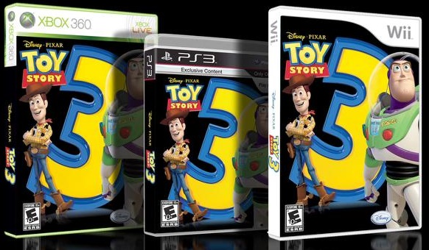
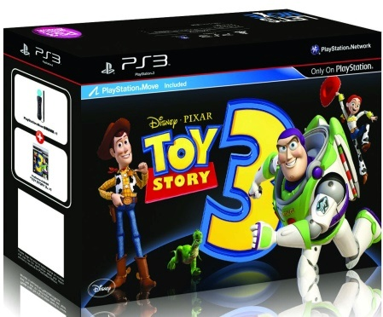
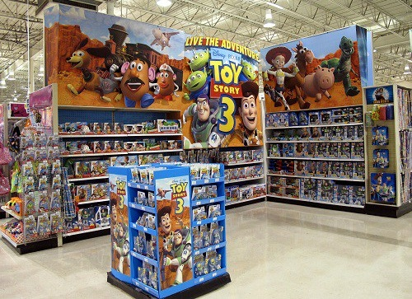
P2.1 – Game Concept Outline
P2.1 – Task 04 – Create a proposal report that outlines the Control Method and Host Platform needs for the proposed game.
Control method – On Playstation and xBox, the control method will be with the joypads, the usual movement control, up, down etc. On PC the controls will be with keys and mouse. Because of the visual nature of the film and the game, there will need to be a camera control option to look around as this will suit the adventure searching elements of the game.
Host platform – The game will be available on console and PC, specifically because the visual elements on the game will require a high level of graphic ability not suited to handhelds of tablets. This will mean a bigger budget release of the game, linked to the film release and will need to contain most if not all of the film content.
This may also cater for a degree of merchandising to be sold with the game in bundle form.

Slide 12
M1 – Gain Feedback from the Client
Learners are required to present the game concept to obtain feedback. The presentation can take any format but must give the stakeholders a good overview of the game content, how it will work and the decision making process behind the game concept.
M1.1 – Task 05 – Create a feedback questionnaire for the client based on the concept proposal.
For the first part of this task, prepare a questionnaire with 10 questions, 6 with yes/no styled questions (specification of the game, genre, platform e.g. graphic ability), 2 with feedback questions (why) and two with concept recommendation questions.
Stage – What the levels should be like, how many, what format.
Characters – Who, how and seen from what perspective (FPS or 2D)
Progression – how does the client see the character progressing
Scoring – Mechanisms, power ups or levelling up.
Fun – what level of seriousness does the client expect.
Suitability for target audience – Age range and content suitable
M1.2 – Task 06 - Gain Feedback from the client on the Concept Specification

Slide 13
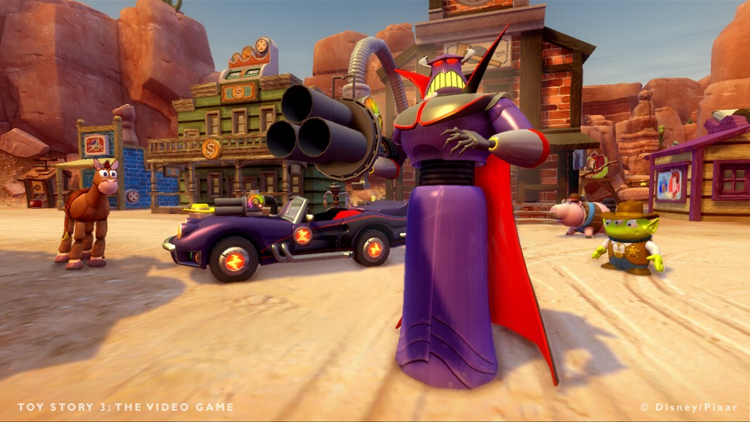
P3 – Presenting the Game Concept
Learners are required to present the game concept to obtain feedback. The presentation can take any format but must give the stakeholders a good overview of the game content, how it will work and the decision making process behind the game concept.
P3.1 – Task 07 – Present the concept to the stakeholder
The presentation needs to be broken down into the following sections for the client.
Overview of concept
Visualisation
Reasons for decisions made
Available options
Viability of design
Resources required
The feedback can be through written questionnaires or verbal. If verbal, there should be some form of audio/video recording.

Slide 14
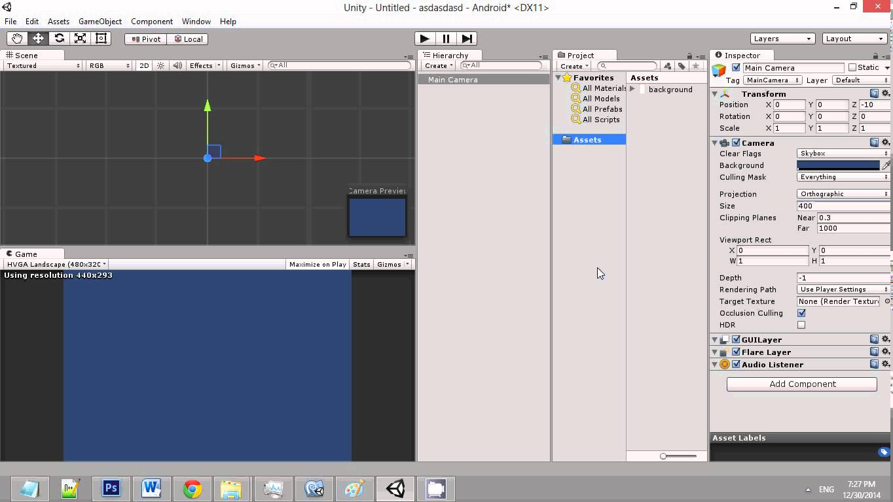
P4 – Design Production - Software
For P4, you are required to produce the design for the game concept taking into account the stakeholder feedback. The design should be sufficiently detailed to allow a third party to develop the game. The design documentation selected is flexible.
For this task you are required to produce evidence of concepts from the list below:
Choice of software for game development
Pseudocode
Storyboard
Mood board
Help
Assets
For each of these there should be some evidence of the production so that the game can be made based on these concepts.
Choice of software for game development - Look at the different choices of game producing software and decide with explanations on which one would be best suited for the purpose of producing this particular game.
Look at Unity, Unreal, Cry, Scratch, GameMaker. Evidence your findings.
P4.1 – Task 08 – Create a report that explains your choice of game development software.

Slide 15
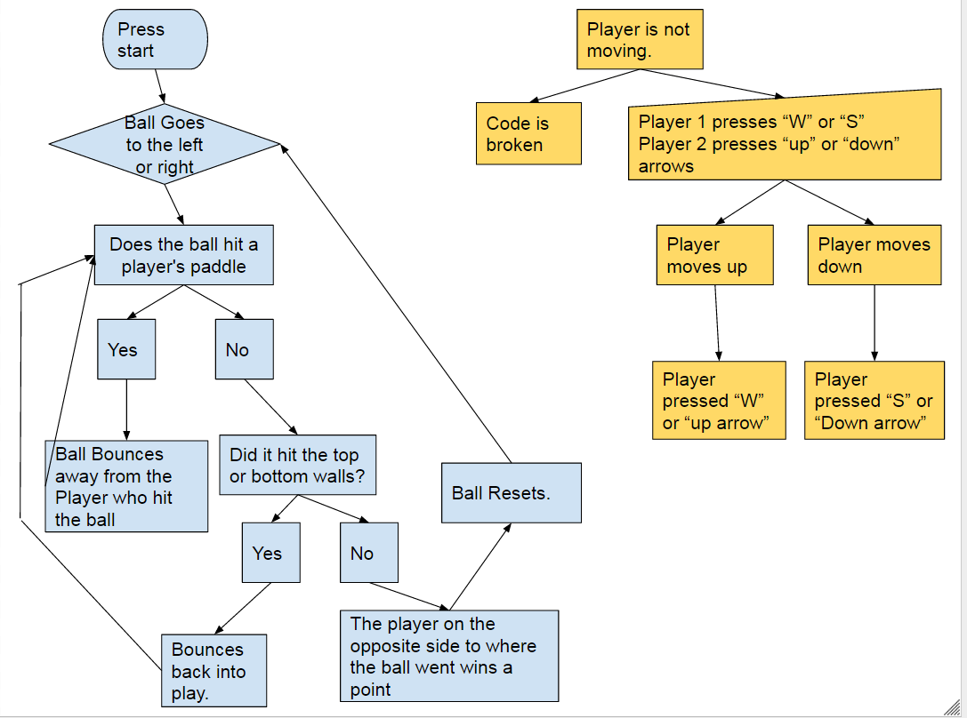
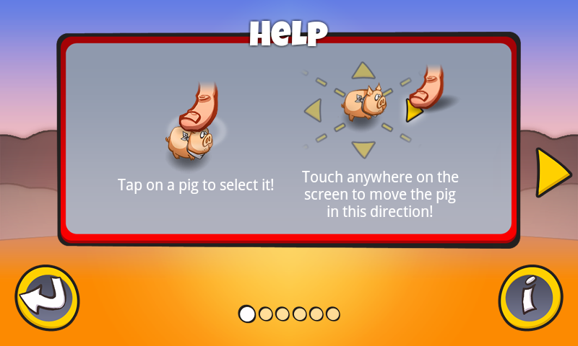
P4 – Design Production – Pseudocode and Help
Pseudocode – Create 3 flow chart diagrams that explains some of the procedures that the game will need to take when the character moves or interacts with an object. Make these varied so a programmer might be able to write in the pseudo code and instruction set on how to make the character do things.
Help – In your report explain the help procedures your game should include to benefit progress with the players. Explain if this help will be in the manual, online or in-game, what method this help will take, how many clues will you give such as tool explanations or how to control the character.
P4.2 – Task 09 – Create a report that explains your choice of Help features and Pseudocode actions.

Slide 16
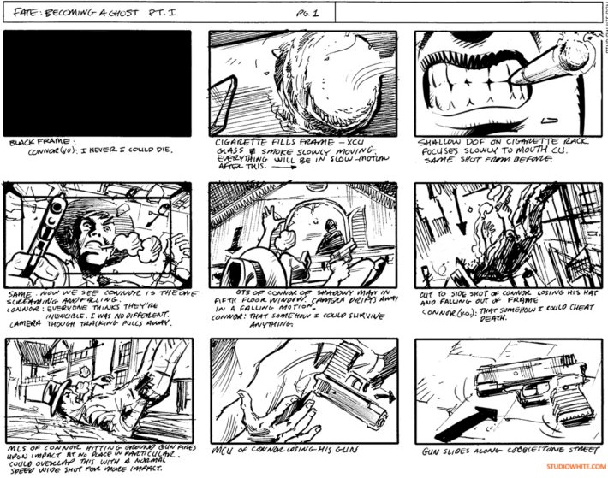
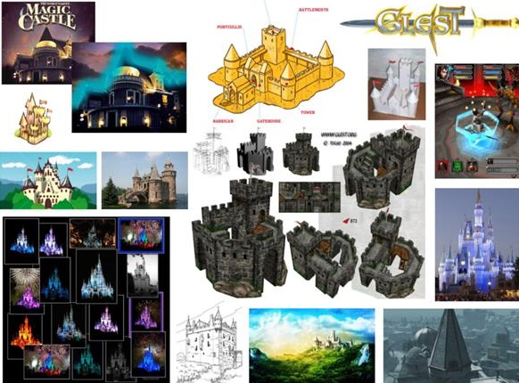
P4 – Design Production – Pseudocode and Help
Storyboard – Create a storyboard of at least 6 scenes that will demonstrate how the character performs an action or interacts with another character.
Choose a scene that you consider important. For mine it might be when Woody uses Buzz to be flown to a higher level in the game, and how he is called, used and disposed of after the event.
Mood board – This is a page of images and text that helps the programmer get an idea of what to use when creating the assets for the game. Use internet research for the movie and create a mood board of the scenes and characters for the programmer to help create.
P4.3 – Task 10 – Create a report that showcases your storyboards and mood board for the game.

Slide 17
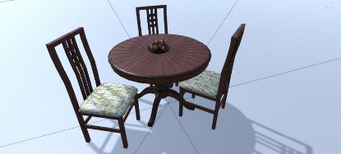
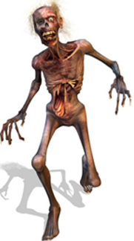
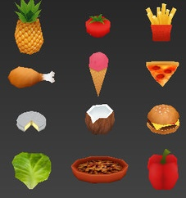
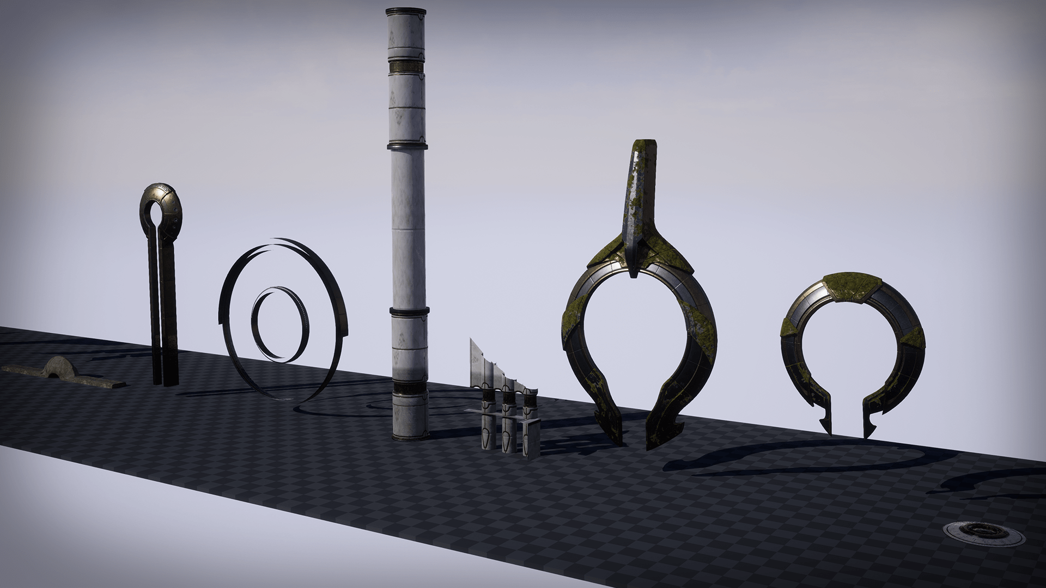
P4 – Design Production – Pseudocode and Help
Assets– These are objects from images , sounds or videos, that are used with a game and can be interacted with or add to the scenery in the background. For all large games, there is a long series of assets from Mushroom and Bananas in Mario, to barrels and trees in Skyrim. These assets are all created or downloaded and placed inside the game as objects (.obj)
For my game for instance I would have a series of objects in the background of the platform sections that would not be available for use, beds, cupboards, balls, additional toys. They would all still be created as they would change when the character moves around them in 3D.
These would be placed as inanimate objects within the game, for instance on the roadside in the driving sections.
P4.3 – Task 11 – Create a report that lists, demonstrates and could be included in your assets for the game.
For this, gather some as examples from here and here.

Slide 18
LO2 – Assessment Criteria
P2.1 – Task 01 – Create a proposal report that outlines the Purpose, type and audience needs for the proposed game.
P2.1 – Task 02 – Create a proposal report that outlines the Story, Stage and Characters needs for the proposed game.
P2.1 – Task 03 – Create a proposal report that outlines the Progression Levels, Scoring and Sound needs for the proposed game.
P2.1 – Task 04 – Create a proposal report that outlines the Control Method and Host Platform needs for the proposed game.
M1.1 – Task 05 – Create a feedback questionnaire for the client based on the concept proposal.
M1.2 – Task 06 - Gain Feedback from the client on the Concept Specification
P3.1 – Task 07 – Present the concept to the stakeholder
P4.1 – Task 08 – Create a report that explains your choice of game development software.
P4.2 – Task 09 – Create a report that explains your choice of Help features and Pseudocode actions.
P4.3 – Task 10 – Create a report that showcases your storyboards and mood board for the game.
P4.3 – Task 11 – Create a report that lists, demonstrates and could be included in your assets for the game.

